Slide 1


K.RAMAKRISHNAN COLLEGE OF ENGINEERING
(AUTONOMOUS), TRICHY
HOTEL MANAGEMENT SYTEM
PRESENTED BY SUPERVISOR
A.GANESH Mr.V.KUMARARAJA, M.E., (PhD),
8115U23EC026 AP/CSE.

Slide 2
PRESENTATION OVERVIEW
Project Introduction
Objective
Problem Statement
Java Concept
List of programming concepts used for respective problem statement
Modules Used
List of Modules
6. Architecture of the proposed system
7. Merits and Demerits
Comparison with other Programming concepts for the same problem statement
8. Program Execution and Output
9. Queries

Slide 3
INTRODUCTION
This Hotel Management System is a simple Java program that helps manage hotel operations. It has a menu-driven interface that allows users to assign staff for housekeeping, collect guest information, book rooms, handle check-in and check-out dates, and create bills. Guests can choose between AC and non-AC rooms, check if a room is available, and get their check-in and check-out dates automatically. The system also calculates the total bill, including room and food charges. This program makes hotel management easier and provides a smooth experience for both staff and guests.

Slide 4
Java Programming - Concepts Used
Class and Methods:
The program is defined inside the Main class, with different functionalities implemented as static methods.
Static Methods:
All methods are marked as static, meaning they can be called directly using the class name or from within the main method without creating an object of the class.
Control Structures:
Conditional Statements: The if-else statements are used for decision-making, such as assigning staff or checking room availability.
Loops: The while(true) loop is used to keep the program running until the user chooses to exit.
Date and Time API:
The java.time.LocalDate class is used for handling dates, particularly for calculating check-in and check-out dates.

Slide 5
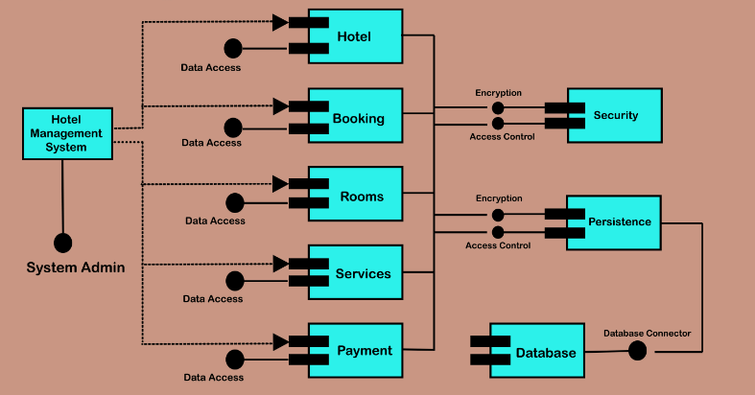
PROPOSED ARCHITECTURE

Slide 6
Proposed Architecture - Description
1. Main Module: Acts as the central hub, connecting all other modules.
2. Staff Management: Handles staff-related tasks like managing staff and assigning housekeeping.
3. User Information: Collects and stores user details.
4. Room Reservation: Manages room availability checks and reservations.
5. Check-In/Check-Out: Handles guest check-in and check-out processes.
6. Billing: Generates bills and calculates total costs

Slide 7
List of Modules
Staff Management
User Information
Room Reservation
Billing

Slide 8
Module Description
Staff Management: Assigns staff for room services and Displays available staff and assigns one based on the user’s choice.
User Information: Collects user details. and Gathers information like name, age, AADHAR, and PAN for record-keeping.
Room Reservation: Handles room bookings. And Lets users pick AC or non-AC rooms and checks if rooms are available.
4. Check-In and Check-Out: Manages stay dates. And Calculates check-in and check-out dates based on how long the user stays.
5. Billing: Generates the bill. And Calculates total costs for the room and food, based on the user's stay.

Slide 9
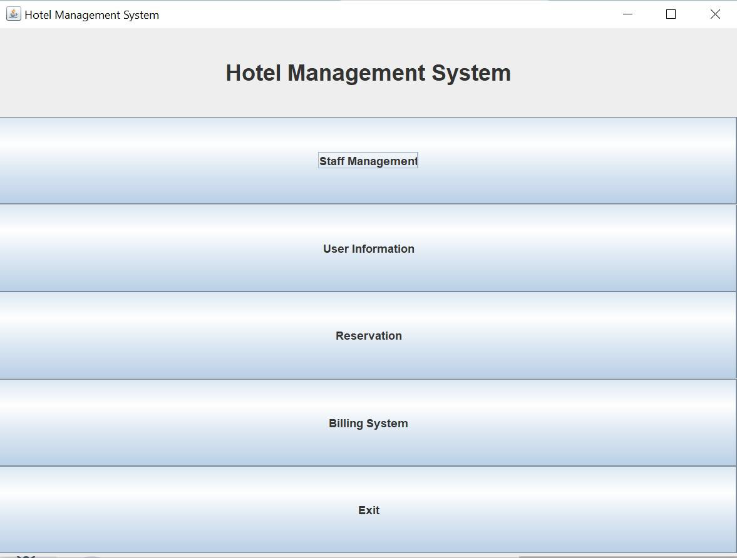
Results and Discussion

Slide 10
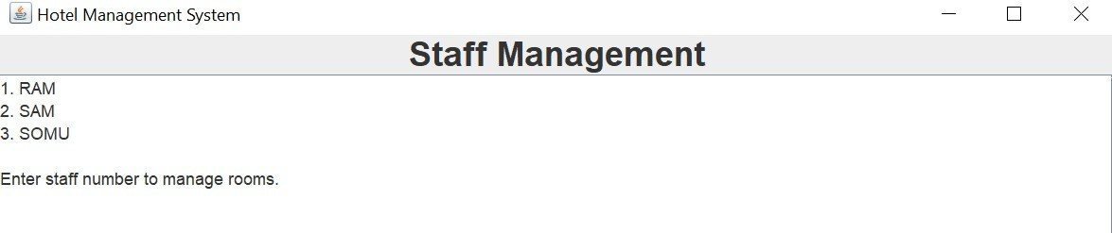
Results and Discussion (Cont..)

Slide 11
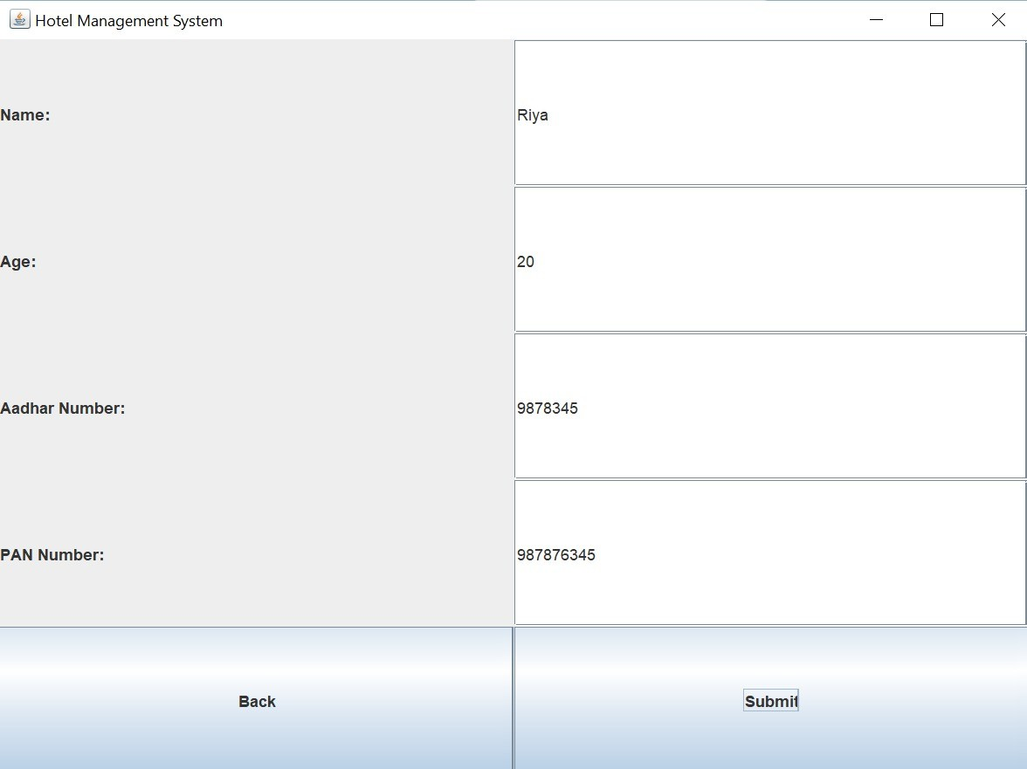
Results and Discussion (Cont..)

Slide 12
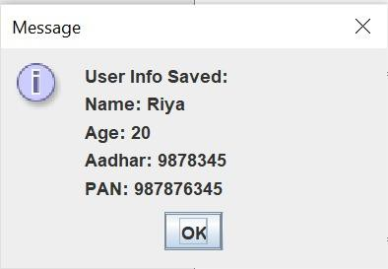
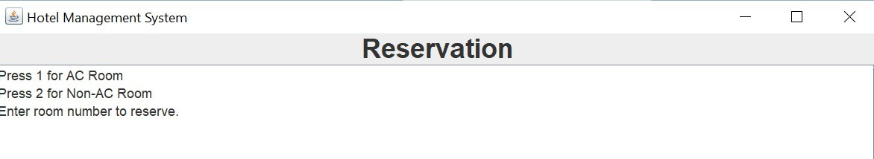
Results and Discussion (Cont..)

Slide 13
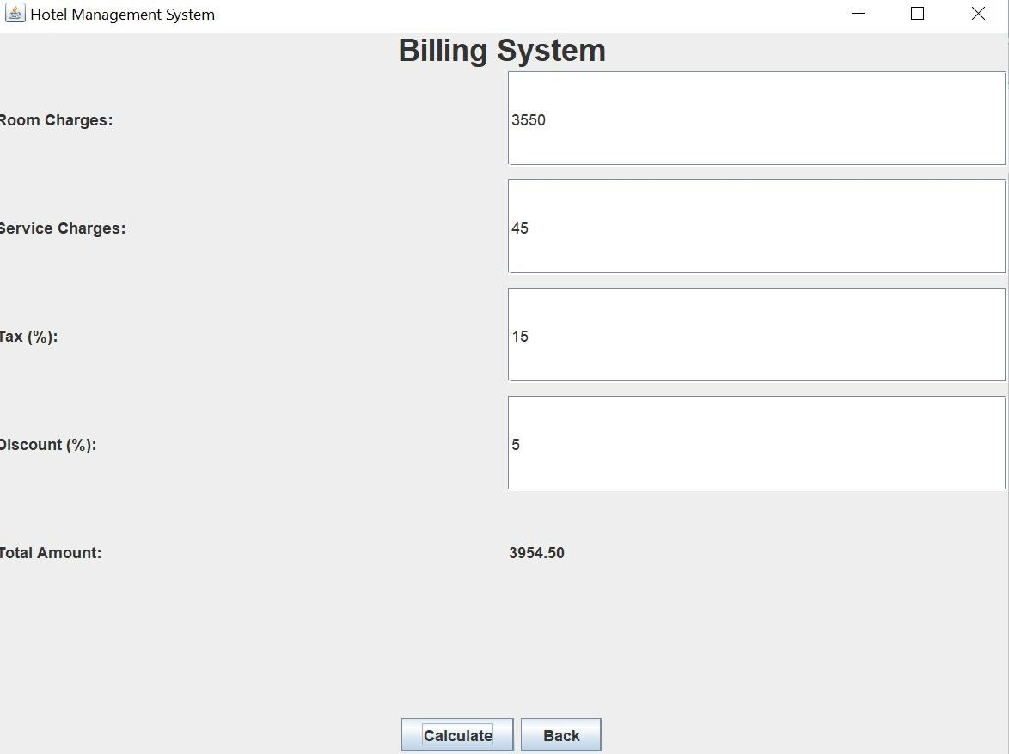
Results and Discussion (Cont..)

Slide 14
Conclusion
The hotel management system simplifies key tasks like assigning staff, booking rooms, managing check-ins and check-outs, and creating bills. By organizing these processes, it helps hotel staff work more efficiently and improves the customer experience. This system is a strong starting point that can be easily expanded in the future.

Slide 15
Thank You

